Slide 1
Group 3
103041006彭琍瑄
104034002楊曦
104034006許婷宣
104034037林玟儒
Notes:
Hi everyone, we are group 3, this is

Slide 2


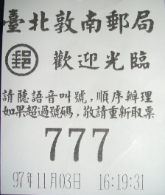
Background & Motivation
Registered mail
sender’s information
receiver’s information
Notes:
First, let me briefly explain the process of sending a registered mail again, you go to the post office, take the number and wait until the server is available, then write down both sender’s and receiver’s contact information on the envelope, and then give the mail to the server, pay for charges, then the server will give the mail a barcode, and the mail will start to be process, the sender can also track the mail with the barcode it’s like an identification for the mail.

Slide 3
Background & Motivation
Registered mail
Don’t know the right position to write
Taking too much time for servers.
Post offices are often filled with people
Not knowing the actual address
Sloppy handwriting
Hard to track the mail
sender’s information
receiver’s information
Notes:
the motivations why we wanted to do build a an additional websites for the registered mail are Many people don’t really know the format that post office required, so they write the information on wrong places, and because of that, servers will spend so much time helping people with things like this, hence, the post offices are always filled with people. Besides, sometimes, people don’t actually know the exact address, for example, if we want to send a mail to teacher Hareesh, we will have to look up the exact address of 清華 university and fill it in, not to mention some people’s sloppy handwriting makes postmen hard to identify. Furthermore, the post office will not notify the sender when the mail is delivered, so the sender have to keep checking the website to know.

Slide 4
I-P-O Cycle or block diagram
Input
process
output
(Data)
- Sender’s information
- Receiver’s information
(Operation)
App processing
- Scan the barcode
Print the info. on the envelope
- Delivery
(Result)
Notify senders via the email
Notes:
Here is our IPO cycle. First we input senders’ and receivers’ contact information in the APP.
Through the APP processing, we can obtain a barcode in exchange for all the information we input.
After the server scans the barcode, the contact information can be printed out and pasted on the envelope.
Hence we can save time and reduce typo simultaneously.
As soon as the mail is delivered, the postman will scan the barcode and the sender can be notified.

Slide 5
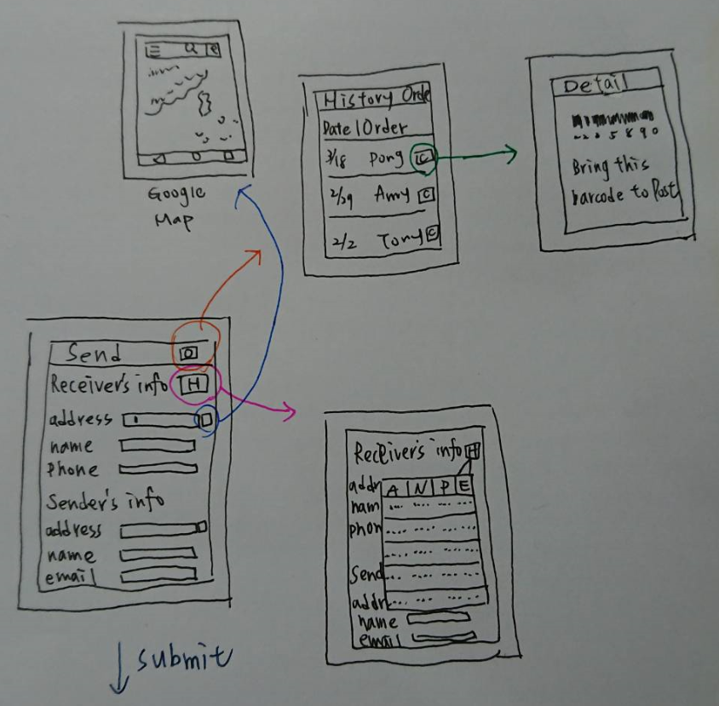
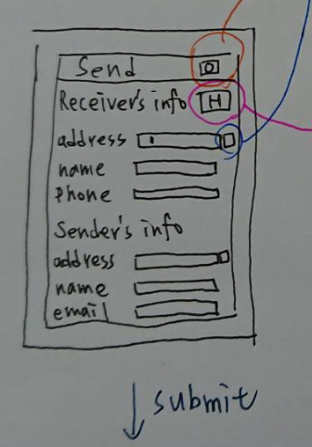
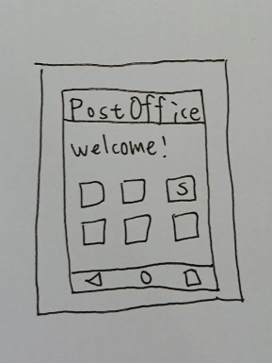
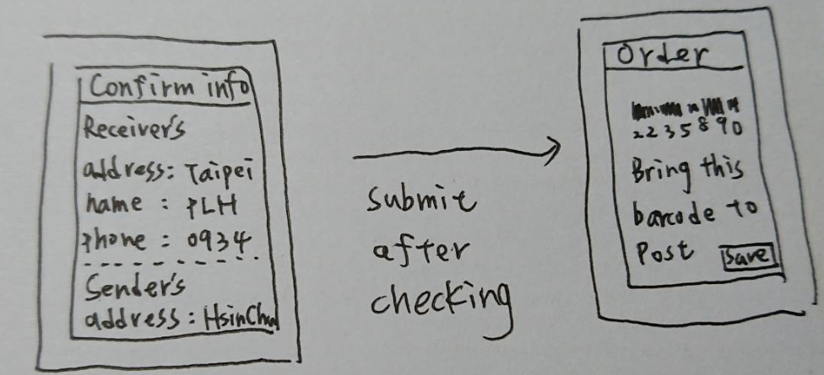
Our Design
Homepage

Slide 6
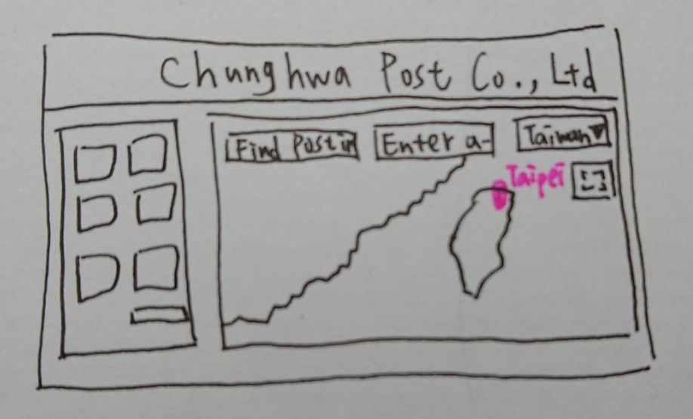
Web Homepage
map
Order info.

Slide 7
Functions of our website
Fixed format to fill in
Avoid format and handwriting problem
Registered mail
Registered mail
Sender’s info:
Sender’s info:
Name:
Zip code:
Address:
Phone:
Email(optional):
Name: David
Zip code:111
Address: Taipei
Phone: 0989
Email(optional):
Receiver’s info:
Receiver’s info:
Name:
Zip code:
Address:
Phone:
Name: Emily
Zip code:300
Address: Hsinchu
Phone: 0910
submit
Notes:
To solve these problem, we design a website that contain some convenient function for senders
For starters, there is fix format in our website that senders just have to fill in all the information that are required. With this, servers will not waste time teaching people, furthermore because the server will print it out, so no more sloppy handwriting!

Slide 8
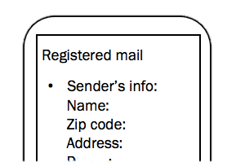

Functions of our website
Fixed format to fill in
Avoid format and handwriting problem
History & Contact
Save sender’s time
Registered mail
Contacts
Sender’s info:
Dad
Name:
Zip code:
Address:
Phone:
Email(optional):
Name: Joey
Zip code:111
Address: Taipei
Phone: 0989
History
Sender’s info -1
Mom
Name: Joey
Zip code:111
Address: Taipei
Phone: 0989
History
Contact
Name: Russ
Zip code:300
Address: Hsinchu
Phone: 0910
Receiver’s info:
Name:
Zip code:
Address:
Phone:
Sender’s info -2
submit
Name: Russ
Zip code:300
Address: Hsinchu
Phone: 0910
Notes:
Second, when filling the sender’s information, they can just simply choose from history, likewise, the receiver’s information can also be chosen from the contacts, senders don’t have to fill them all over again.

Slide 9
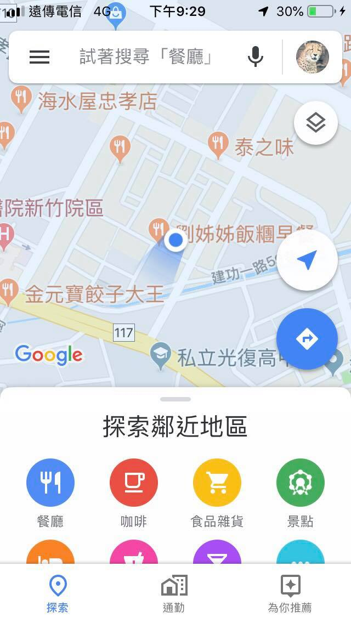
Functions of our website
Fixed format to fill in
Avoid format and handwriting problem
History & Contact
Save sender’s time
Use google map to fill the address
Address Problem
Registered mail
Sender’s info:
Name:
Zip code:
Address:
Phone:
Email(optional):
Google Map
Receiver’s info:
Name:
Zip code:
Address:
Phone:
submit
Notes:
And for the address problem I just mentioned, senders can simply go to google map and type in where to send, and google will find the detailed address then send it back to the website

Slide 10
Functions of our website
Fixed format to fill in
Registered mail
Avoid format and handwriting problem
Sender’s info:
Name: David
Zip code:111
Address: Taipei
Phone: 0989
Email(optional): a@gmail
History & Contact
Save sender’s time
Use google map to fill the address
Receiver’s info:
Address Problem
Name: Emily
Zip code:300
Address: Hsinchu
Phone: 0910
Barcode
Convenient for both servers and customers
Notes:
To lower the server’s serving time, servers can get all the information that are needed by easily scanning the barcode. and print it out

Slide 11
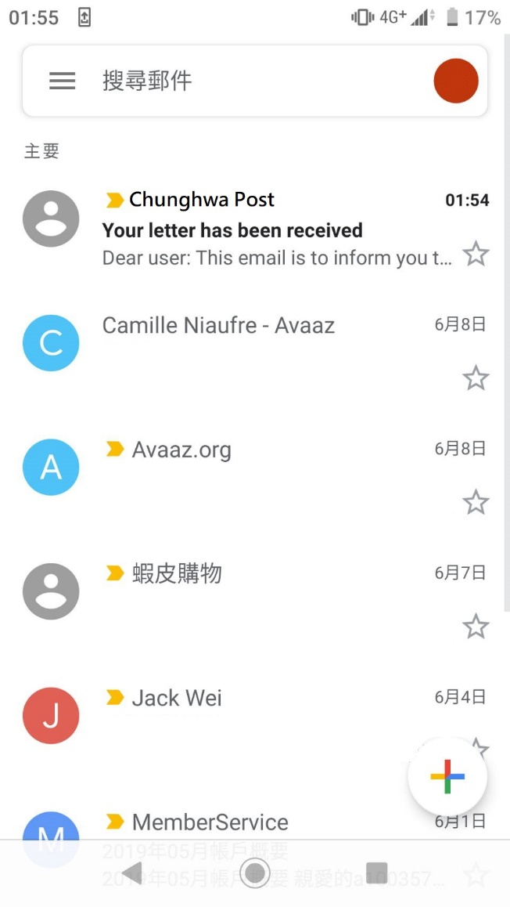
Functions of our website
Fixed format to fill in
Avoid format and handwriting problem
History & Contact
Save sender’s time
Use google map to fill the address
Address Problem
Barcode
Convenient for both servers and customers
Notification
Automatically notify the sender
Notes:
Last but not least, one of the things that senders really care about is if the mail is successfully delivered, so the website will send a notification by email to tell the sender once the receiver get the mail.

Slide 12

最終版本網址放這邊

Slide 13
Q&A

